Slide 1
EPIDERMAL MELANIN UNIT
Definition: functional and structural complex within epidermis consisting of melanocytes and keratinocytes
About 36 keratinocytes are associated with each melanocyte, an association that has been termed as EPIDERMAL MELANIN UNIT

Slide 2
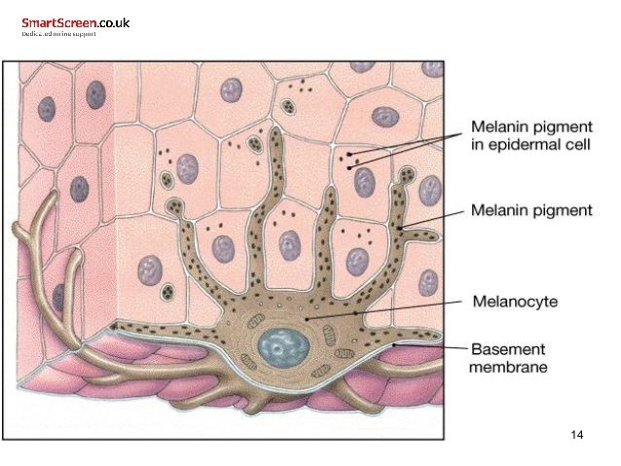

Slide 3
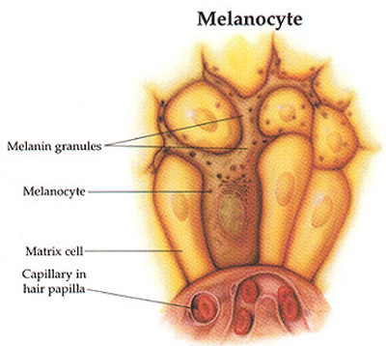
MELANOCYTES
Melanocytes are the dendritic cells that synthesize and secret melanin containing organelles called melanosomes
Derived from neural crest cells melanoblast and migrate to :
epidermis and hair follicle
Dermis
Leptomeninges
Uveal tract of eye
Inner ear

Slide 4
Melanoblasts (Melanocyte precursors) migrate moving dorsolaterally and then ventrally around the trunk to the ventral midline & differentiate into melanocytes
During embryogenesis, melanin-producing melanocytes are found diffusely throughout the dermis
At the end of gestation, active dermal melanocytes “disappear”, except in three anatomic locations
the head and neck,
the dorsal aspects of the distal extremities,
the presacral area that coincide with the most common sites for dermal melanocytosis and dermal melanocytomas (blue nevi)

Slide 6
Primitive melanocytes: 8th wk. gestation
early melanization:10th wk. gestation
Differentiation to melanocytes: 6 months
Fetal skin contain melanocytes in the dermis basally, suprabasally
Neonatal skin contain melanocytes only basally

Slide 7
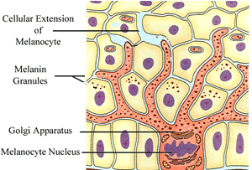
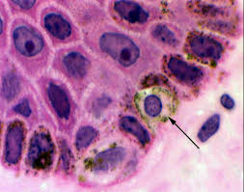
Microscopy: Melanocytes appear as clear cells in and immediately beneath the basal row of the epidermis
Hematoxylin and eosin stained section shows :
-average no of melanocytes is one out of ten in basal row
-wedged between the basal cells of the epidermis
-nucleus of melanocyte is smaller and more deeply basophilic than that of basal keratinocytes with clear cytoplasm

Slide 8
The concentration of melanocytes vary according to region of body
Face : upto 2900/sq.mm
Trunk : upto 1250/sq.mm

Slide 9
TYPES OF MELANOCYTES
1- SECRETORY MELANOCYTES: Present in basal layer of epidermis form network of dendrites in the basal layer They act as unicellular glands producing melanosomes that are transferred to surrounding epidermal keratinocytes
2- NON-SECRETORY MELANOCYTES: Called MELANOPHORES do not transfer melanosome but redistribute them from perinuclear zone into dendrites and back again

Slide 10
MELANOGENESIS
Melanosomes : Is membrane-bound unique organelle within the cytoplasm of melanocytes in which melanin pigments are synthesized, deposited and transported

Slide 11
Stage I
Melanosomes are spherical
Membrane bound vesicles with longitudinally oriented concentric lamellae
possess very intense enzyme activity concentrated along filaments
contain no melanin

Slide 12
Stage II
Melanosomes are ellipsoid
measure approximately 0.5 µm in length
contain numerous lamellae that are cross-linked with one another
Melanin deposition on the cross-linked filaments begins at this stage

Slide 13
Stage III
Melanosomes have only little tyrosinase activity but show continued melanin deposition
The lamellar network is obscured by melanin deposition
Stage IV
Melanosomes no longer possess tyrosinase activity Melanin is formed by nonenzymatic polymerization
Electron opaque due to dense melanin deposits
Seen as vesiculoglobular bodies
Length is 0.4microm in whites and 0.8 in blacks

Slide 14
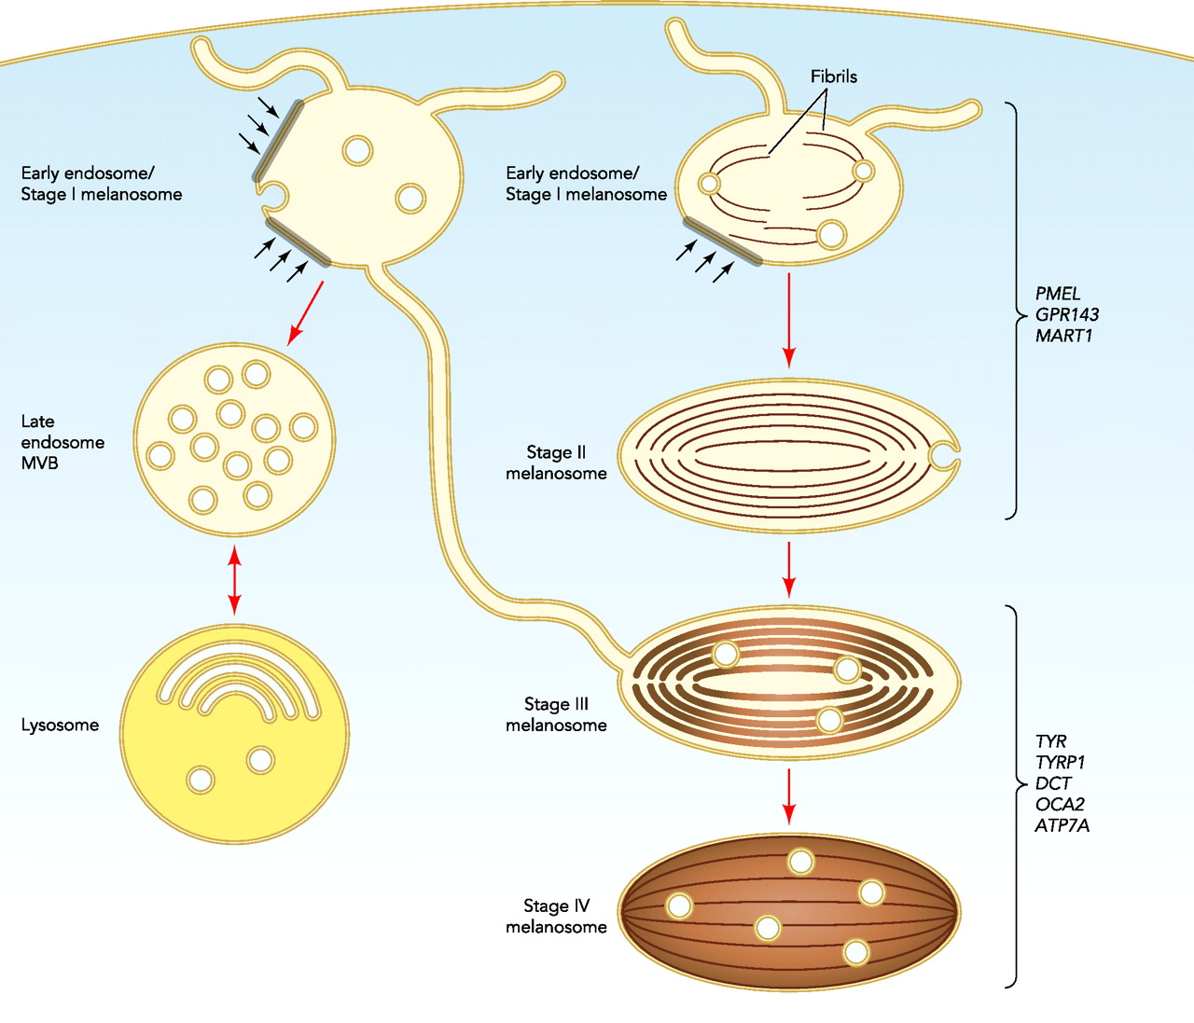

Slide 15
Melanosomes in their development from stage I to stage IV gradually move from the cytoplasm of the melanocyte into the dendritic processes
As melanosomes mature, their content of melanin increases, and their concentration of melanogenic enzyme tyrosinase decreases and acid phosphatase increases
Acid phosphatase help in degradation or transfer of melanosomes

Slide 16
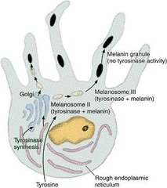

Slide 17
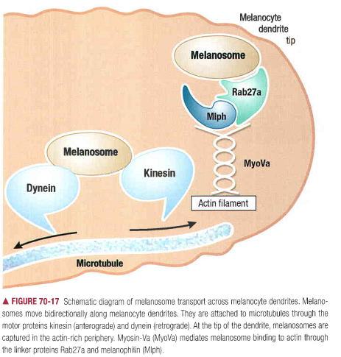
Transfer of melanosome within melanocytes
Melanosome transport takes place on microtubules that are arranged parallel to the long axis of the dendrite

Slide 18
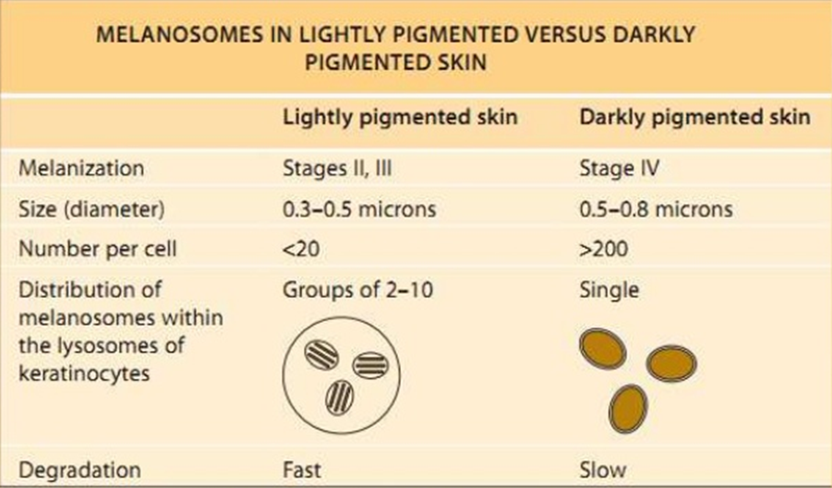

Slide 19
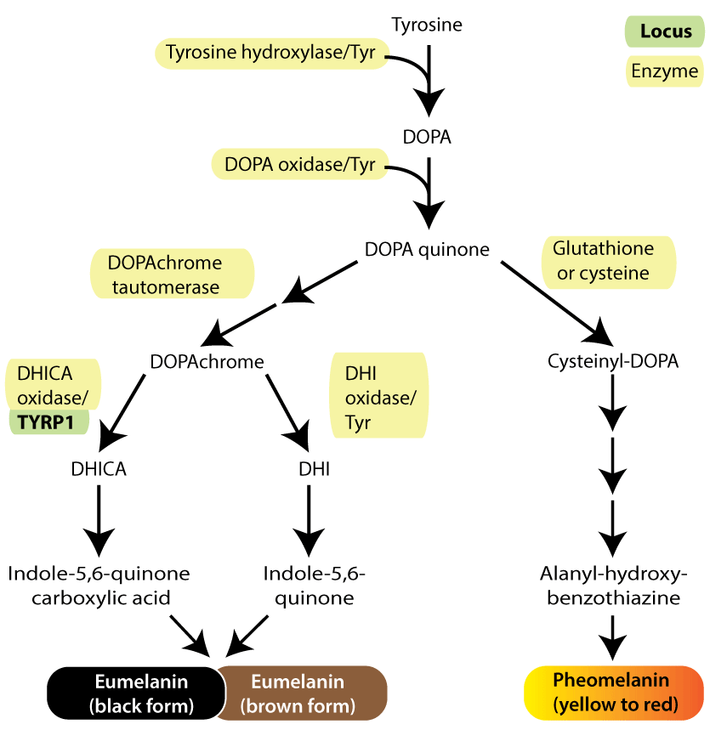
Enzymatic melanogenesis involves tyrosinase as the melanogenic enzyme
tyrosine
tyrosinase
dihydroxyphenylalanine(DOPA)
dopaquinone

Slide 20
The conversion of tyrosine to melanin by tyrosinase is characterized by a variable lag period. When tyrosinase is present in low concentrations, as in epidermal melanocytes of nonirradiated skin, the lag period is markedly prolonged

Slide 21
MELANOGENIC PROTEINS
1)Enzymes regulate the biosynthesis of melanin
a) Tyrosinase,
b) TRP-1 (Tyrosinase-Related Protein 1)
c) TRP-2
d) Protein kinase c-beta
2) Structural proteins matrix proteins which form a scaffolding upon which the melanin is deposited
a) Pmel17 (Premelanosome protein)
b) MART-1 (Melanoma Antigen Recognized by T cells)
3) Regulatory proteins
a)MC-1R (Melanocortin 1 receptor)
4) Additional melanogenic proteins (P Protein, Heterotetrameric adaptor protein comlexes )

Slide 22
TRANSFER OF MELANOSOME TO KERATINOCYTE
1) Exocytosis: fusion of the melanosomal membrane with the melanocyte plasma membrane, melanosome is released to the intercellular space and phagocytosis by surrounding keratinocytes occur
2) Cytophagocytosis: projection of dendrites into keratinocyte cytoplasm then keratinocytes cytophagocytose the tip of a melanocyte dendrite
This snipping off the tips of dendrites is known as APOCOPATION
3) Fusion of melanocyte & keratinocyte plasma membrane create a space through which melanosomes are transferred
4) Shedding of melanosome-filled vesicles followed by phagocytosis of the vesicles by keratinocytes

Slide 23
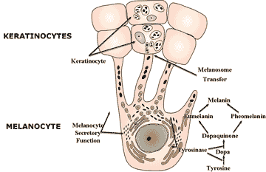

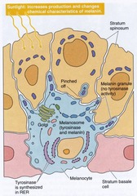

Slide 24
TYPES OF MELANIN
Eumelanin (brown, black)
Pheomelanin (red-yellow)
Stains :
Fontana-masson stain
Bleaching agents like hydrogen peroxide, potassium permangnate
Immunohistochemistry with antibodies to S-100 protein, HMB-45, MART-1

Slide 25
EUMELANINS | PHEOMELANINS
Black or brown | Yellowish to reddish brown
Insoluble in all solvents | Alkali soluble
Nitrogenous pigment | Contains sulphur in addition to nitrogen
Manufactured in ellipsoidal melanosomes | Manufactured in spherical melanosomes
 | Females> males
 | Present in lips, nipples, vagina, glans penis

Slide 26
The amount produced is dependent on:
-genetics
-the amount and the wavelengths of ultraviolet light received
-the amount of melanocyte-stimulating hormone(MSH) secreted
- the effect of melanoccytestimulatingg chemicals like furocoumarins(psoralen)

Slide 27
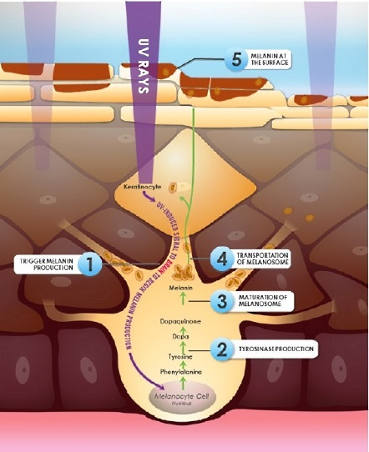
Factors modifying melanogenesis
Increase
UV radiation
Hormones : MSH, ACTH,
lipotropins, estrogen,
progesterone, thyroxine

Slide 28
Melanogenic Stimulator
PROOPIOMELANOCORTIN AND DERIVED PEPTIDES
MSH and ACTH are potent stimulators of
Melanogenesis
synthesized by pituitarygland, & epidermal keratinocytes
Has effect on melanogenic proteins and eumelanin synthesis
Enhances the repair of UV-induced DNA damage in melanocytes

Slide 29
ENDOTHELIN-I
Appears to play a role in mature melanocytes, inducing melanogenesis by activating tyrosinase and increasing TRP-l levels
ETI also leads to melanocyte proliferation and promotes dendrite formation
INFLAMMATORY MEDIAT0RS
Can affect skin pigmentation
PGs (arachidonic acidderived metabolites) and leukotrienes affect melanocyte function
Level is elevated in sunburned skin and in a
variety of inflammatory dermatoses, including atopic dermatitis

Slide 30
Decrease
ageing
Reduction in number & activity of melanocytes occurs with ageing i.e. 6-8% per decade, more of follicular melanocytes & spared epidermal melanocytes from sun exposure are declined leading to graying of hair & lightening of skin color

Slide 31
COMPARATIVE FEATURES OF PREMATURE, NEWBORN, AND ADULT SKIN MELANOCYTES
• Adult: Numbers decrease with age; melanin production depend on skin type, body area
• Newborn: Similar number of cells to young adult; low melanin production • Premature: High number of cells; few mature melanosomes

Slide 32
FUNCTIONS OF MELANIN
1) Provide protection against UV-induced DNA damage by absorbing & scattering UV radiation (280-400 nm)
2) Gives the skin, eyes, hair their color
3) Neutralizer of toxic, free radical oxygen derivatives, by products of various inflammatory processes

Slide 33
NORMAL SKIN COLOR
Depends on
Epidermis - by exogenously produced carotenoids (yellow)
- by endogenously produced melanin (brown, black, Or yellow-red) amount & location
thickness of the granular layer

Slide 34
Skin colour can be
Constitutive: genetically determined
Based on biological potentiality of epidermal melanin units
Facultative: induced pigmentation because of UV radiation, hormones

Slide 35
Variations in skin color
Depends on:
the number and size of melanosomes
the degree of melanization
Degree of melanosome degradation
the distribution of the epidermal melanin unit
Type of melanin (eumelanin, or pheomelanin)
And does not depend on no. of melanocyte

Slide 36
Hair colour: the follicular melanin unit undergoes cyclic modifications in coordination with hair cycle
Hair color is determined by amount of melanin transferred to keratinocytes forming the hair shaft as well as by the ratio of eumelanin to pheomelanin

Slide 37
SKIN PHOTOTYPES
SKIN PHOTOTYPE | SKIN COLOUR | RESPONSE TO UV IRRADIATION
I | White | Always burns , does not tan
II | White | Burns easily , tans with difficulty
III | Beige | Mild burns , tans gradually
IV | Brown | Rarely burns , tans easily
V | Dark brown | Very rarely burns , tans very easily
VI | Black | Never burns , tans very easily

Slide 39
Tanning Response
UV irradiation induces tanning so-called facultative skin color, an increase above baseline or constitutive skin pigmentation that provides protection against UV irradiation
Tanning is divided into immediate
tanning and delayed tanning

Slide 40
IMMEDIAIE TANNING
Immediate tanning,or immediate pigment darkening, occurs within 5 to 10 minutes of exposure and fades within minutes to days depending on the UV dose and the complexion of the individual
Immediate tanning is only visible in darker individuals and is of greyish-brown color,
and it is thought to represent melanosomal relocation to melanocyte dendrites

Slide 41
DELAYED TANNING
Delayed tanning, occurs within 3 to 4 days after UV exposure
More due to UVB (280 to 320 nm) then UVA (320 to 400nm)

Slide 42
lmmediate Tanning vs. Delayed Tanning
 | Immediate | delayed
Onset | Minutes | 3-4 days
Peak intensity | Minutes to few hours | 10-28 days
Fading | Within 24 hrs | Weeks
Mechanisms | Redistribution of melanosomes | Inc keratinocyte-derived melanogenic cytokines Inc Tyrosinase level and activity Inc Melanin synthesis Inc Melanocyte dendricity Inc Melanosome number Inc Melanosome transfer Inc Mehnocyte prolifera

Slide 43
Photoprotection | Unchanged | Increased
Change in skin colour | Undetectable in fair skin Subtle in darker skin | Obvious in most light-skinned and all dark-skinned individuals

Slide 44
Racial variation
Characters | Racial types of skin Caucasoid | Negroid
1) Number of active epidermal melanin units | Less | More
2) Melanosome shape | Rounded | Ellipsoid
3) Melanosome size | Smaller | Larger (about 1 micron in length)
4) Melanosome melanization | Less | More
5) Melanosome packing within keratinocytes | Groups of 3 or 4 packed together | Packed individually

Slide 45
6) Melanosome distribution within keratinocytes | Aggregated | Widely dispersed
7) Melanosome degradation within keratinocytes. Onset b) Degree | Early Intense ( degradative changes can be detected ven at the basal layer of epidermis ) | Late Mild ( intact larger melanosomes may be seen even in the granular layer of epidermis)

Slide 46
Pigmentary disorder
Hypomelanosis
a. Absence of epidermal melanin (e.g. albinism, nevus depigmentosus, leukoderma)
b. Reduction of epidermal melanin (e.g. Pityriasis versicolor, vitiligo, post-inflammatory hypopigmented patches)

Slide 47
Hypermelanosis
a. Increased epidermal melanin (e.g. sun tanning, melasma, freckles, lentigines, nevus spilus, nevus of Ota, Becker’s nevus, chronic inflammatory patches)
b. Increased sub-epidermal melanin (e.g. lichen planus, lupus erythematous, post-inflammatory pigmentation

Slide 48
THANK YOU

